Slide 1
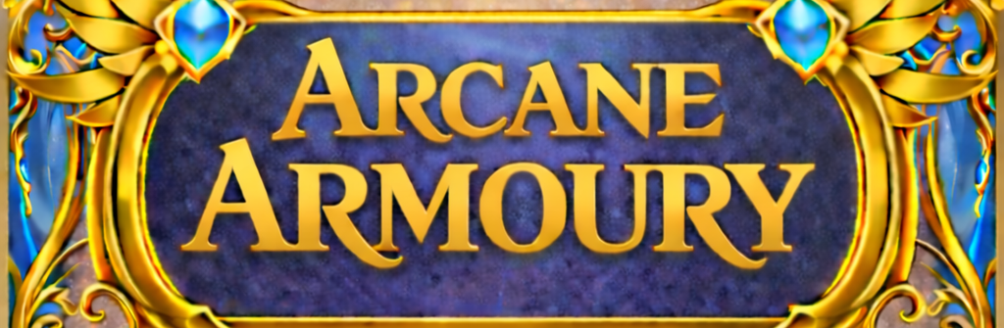
A Dungeons and Dragons Program

Slide 2
Agenda
Members
The Arcane Armoury Project
Scope
Tech Stack
Demo
The Good Things
Challenges
Lessons learned

Slide 3
The Members of the Arcane Armoury Project
.
Alex
Carter
Brayden
Frontend coder
Remote
Poster
ESP 32U coder
3D design
3D Printing
Remote
Raspberry pi setup
Backend coder
Troubleshooting

Slide 4
The Arcane Armoury Project
The idea of the project is to have a dual monitor setup, one monitor for the Dungeon Master and one monitor for the Players to view.
The purpose of this is to have a digital semi-interactable interface for players to actively engage in as a group.
This project is set up on a Raspberry Pi 4, alongside a remote made using a breadboard and an ESP 32U, as well as two monitors.

Slide 5
Scope of Arcane Armoury Project
The primary program
An interface for the Dungeon Master to have the ability to change the background, character portraits, and player turns.
A remote controller for players to be able to raise and lower the state of their current Health points
Notes:
The primary program that would be responsible for the majority of the project's functionality.
An interface for the Dungeon Master to have the ability to change the background, character portraits, and player turns.
A remote controller for players to be able to raise and lower the state of their current Health points
A 3D printed shell casing for the remote controller.

Slide 6
The Tech Stack
A program that uses python, java script, HTML, and CSS
A remote controller using breadboard components and Bluetooth
A 3D printed shell casing for the remote controller.
Dual Monitors
A single Raspberry Pi 4
Notes:
Allow us to demonstrate the final product

Slide 7
Demo Time

Slide 8
The Good Things
GitHub
The ESP 32U/Bluetooth
Communication
Notes:
Thanks to GitHub’s ability to create issues for all members of the team to see, it made communication on the various issues during production far easier to diagnose and assess.
The ESP 32U/Bluetooth functionality was surprisingly simpler than we originally anticipated having to only add a few more lines of code to make it compatible with the current version of the program.
Communication initially was semi lacking, and it occurred to us all during the project how vital and instrumental communication can be during larger more complex projects.

Slide 9

The Challenges
The Remote
The Primary Program
Notes:
One of the bigger issues we faced was on the remote aspect on the project. For unknown reasons at the time one of the buttons failed to operate. This proved to be very challenging as it took quite some time to diagnose the core issue responsible for the malfunction.
The primary program proved to have its own set of challenges, the moment you would fix a single issue another would rise and take its place such as lining up the health bars on the HTML aspect, the printing of the remote shell, and various other issues that we did not originally anticipate would be major issues.

Slide 10
Lessons learned
Proper communication
Sticking to the project scope
Notes:
As previously stated, proper communication was far more valuable than originally anticipated. It was a hard lesson to accept but one we had to adapt to nonetheless
Sticking to the project scope can sometimes be difficult, especially when later down the line you think of various ways to improve things at the cost of going off scope.

Slide 11
Thank you!
Notes:
We learned largely about the importance of communication, the various services offered freely on GitHub, how to create functioning technical objects using Breadboards, as well as large number of things related to programming.
Ultimately the project was a challenge but one we will be better prepared for next time such a challenge arises.

